Slide 1
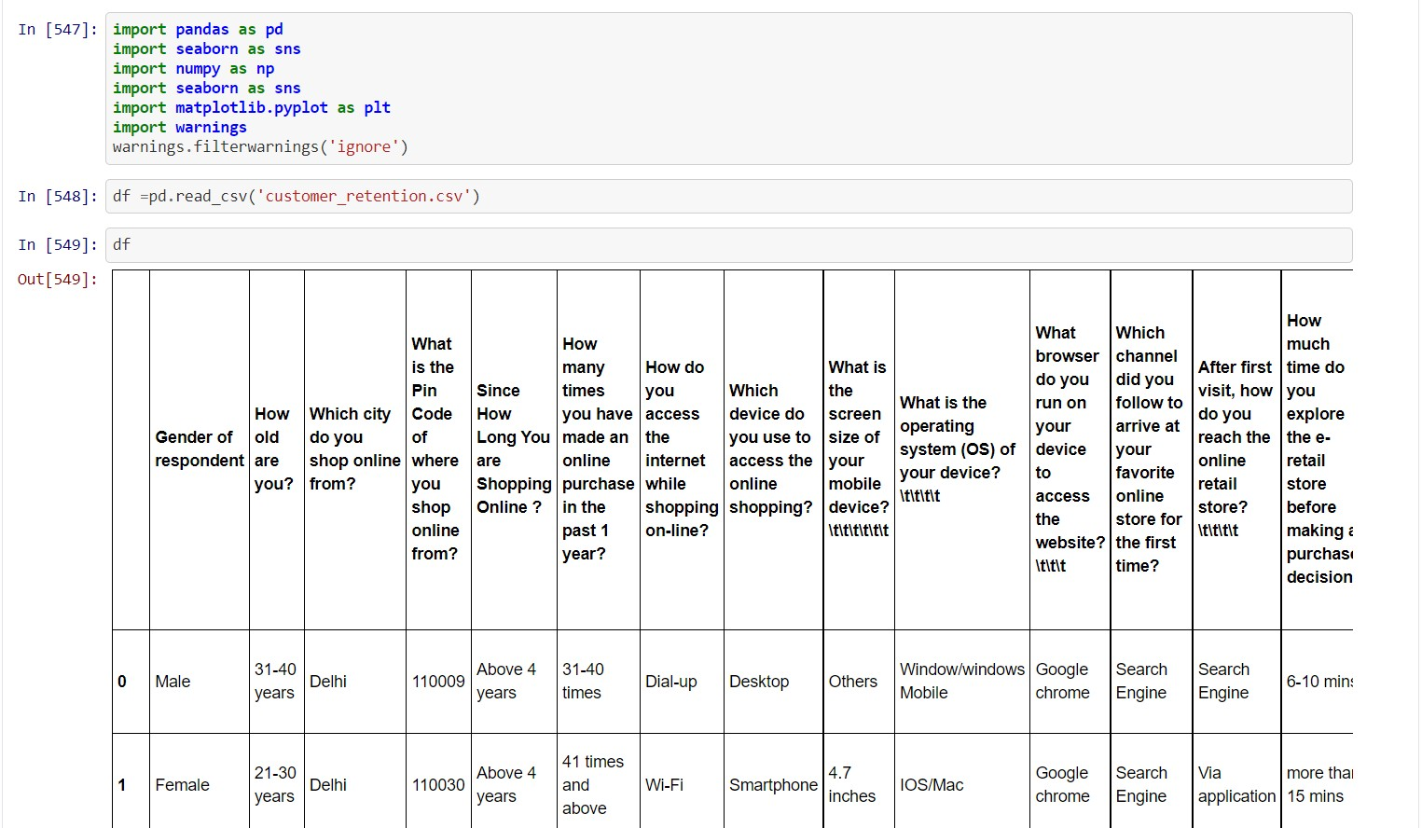
Customer Retention
Customer retention refers to the activities and actions companies and organizations take to reduce the number of customer defections. The goal of customer retention programs is to help companies retain as many customers as possible, often through customer loyalty and brand loyalty initiatives. It is important to remember that customer retention begins with the first contact a customer has with a company and continues throughout the entire lifetime of the relationship.
Load the basic libariries and Load the data of customer Retention
There many columns that show how customer action towards company in this case e-retailer e- commerce platform
df.columns
show the columns present in data set

Slide 2
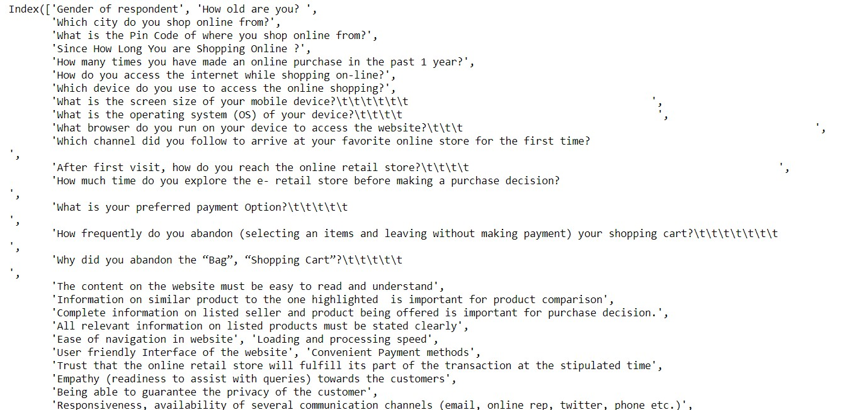
#### display max columns and rows pd.set_option("display.max_columns", None) pd. set_option("display.max_rows", None)
### Replace the space and unwanted space from columns df.columns = df.columns.str.replace(' ', '')
df.columns = df.columns.str.replace('\t\t\t\t\t\t', '') df.columns = df.columns.str.replace('\t\t\t\t', '') df.columns = df.columns.str.replace('\t\t\t', '') df.columns = df.columns.str.replace('\t', '')
### check count of null value df.isnull().sum()

Slide 3
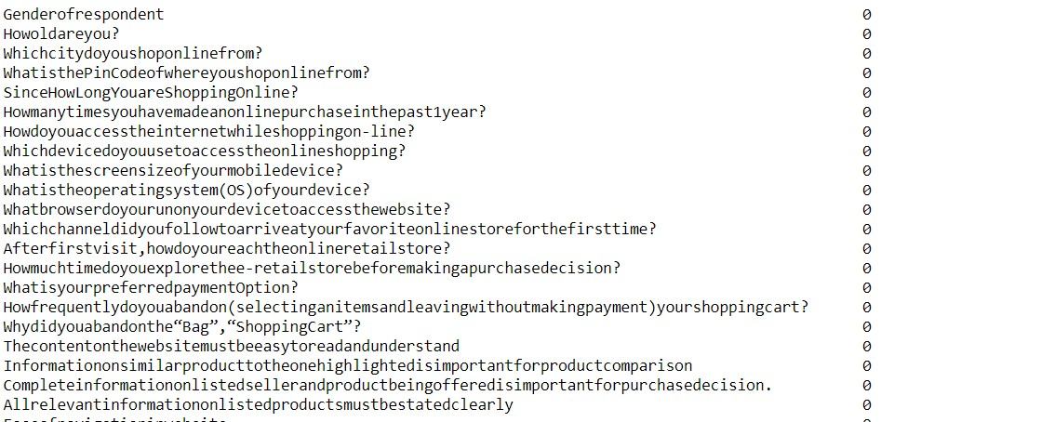
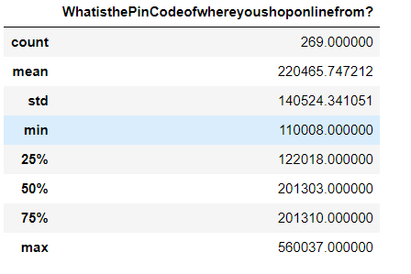
#### statistical description show only numeric value df.describe()
#### statistical data type description df.dtypes

Slide 4
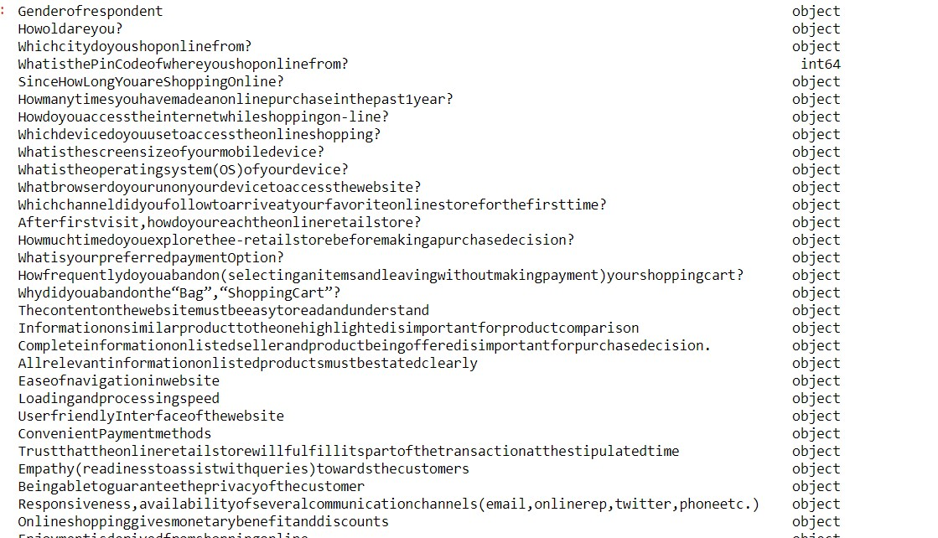
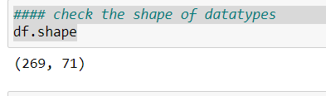
Most of the columns are in categorical form so it is clear to apply encoding technique like label encoder/one hot encoding
#### check the shape of datatypes df.shape
There are 269 Rows and 71 Columns
#### some Data visualization to understand the data set

Slide 5
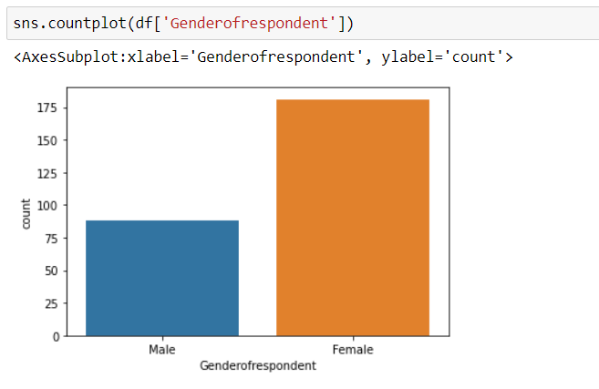
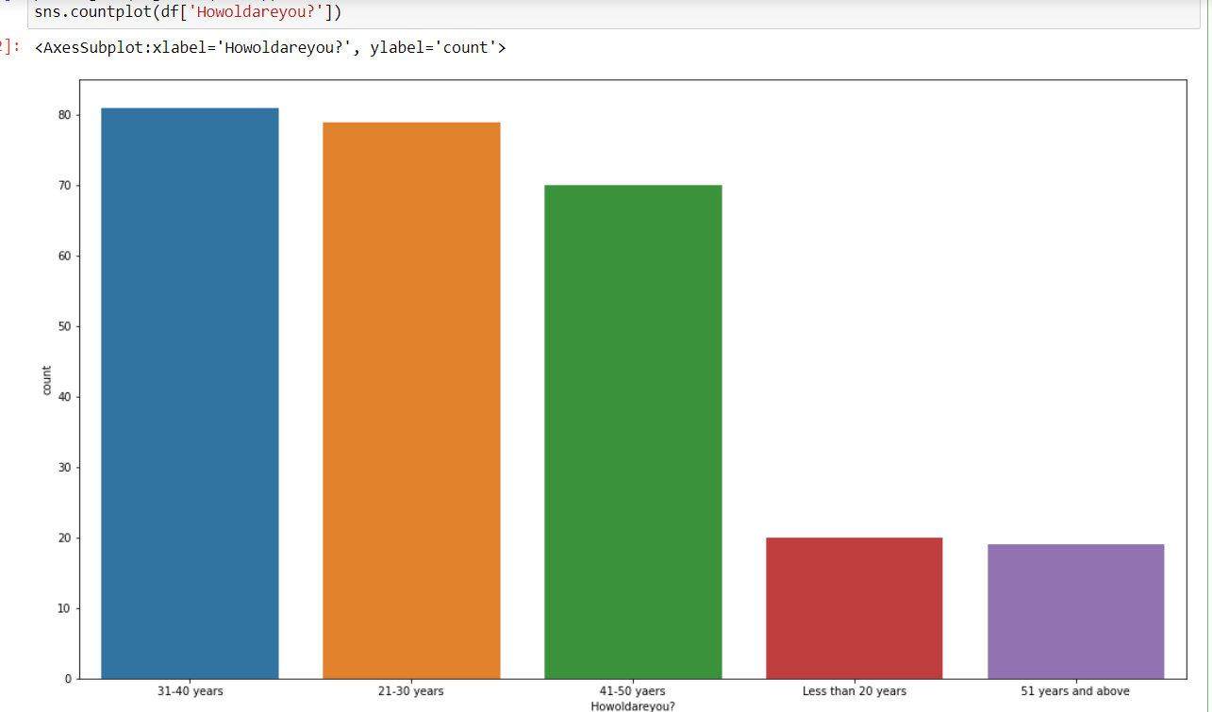
Female count is more than male in term of gender of respondent in e-commerce retailer
Mostly 31-40 years and 21-30 years use e-retailer shop more than others

Slide 6
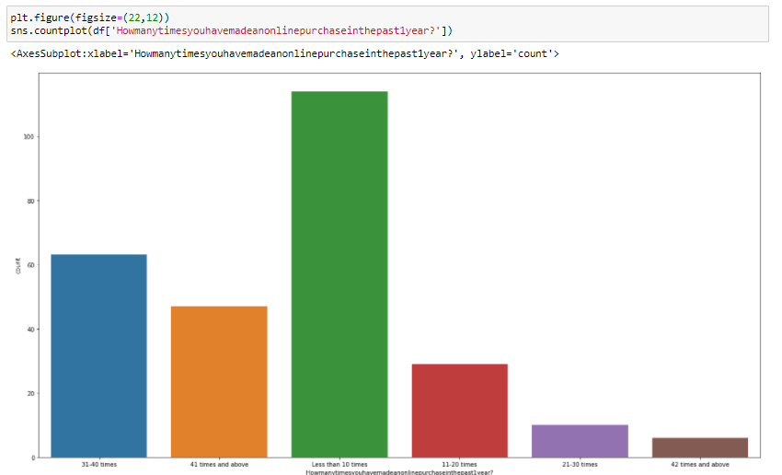
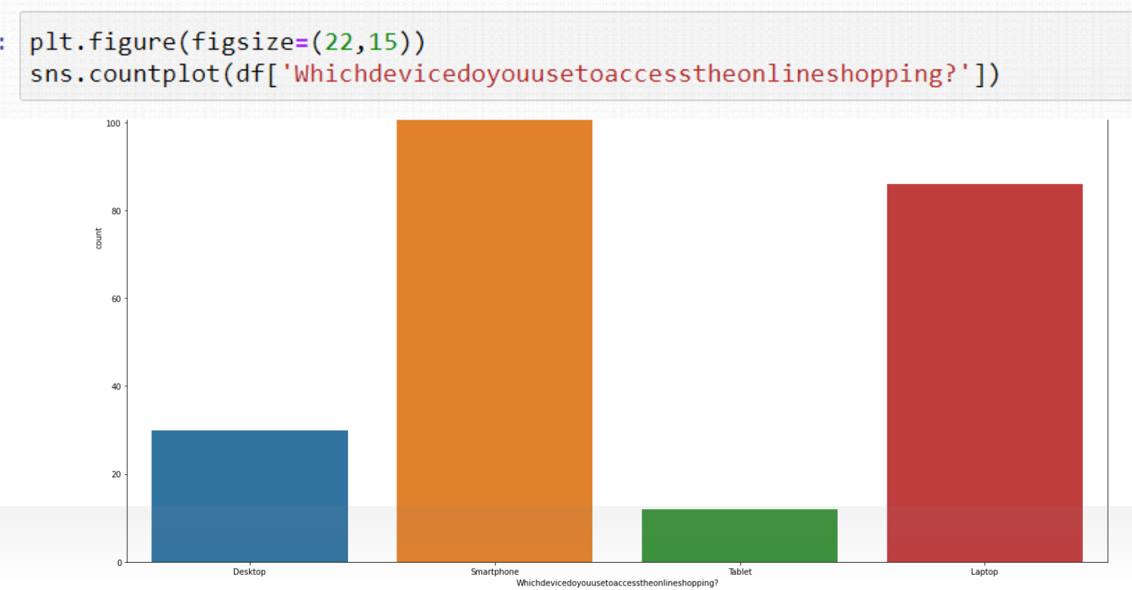
Less than 10 times people did purchase in past 1 years.it means it is not good for the e-commerce platform.
Mostly People use smartphone for oneline shopping.

Slide 7
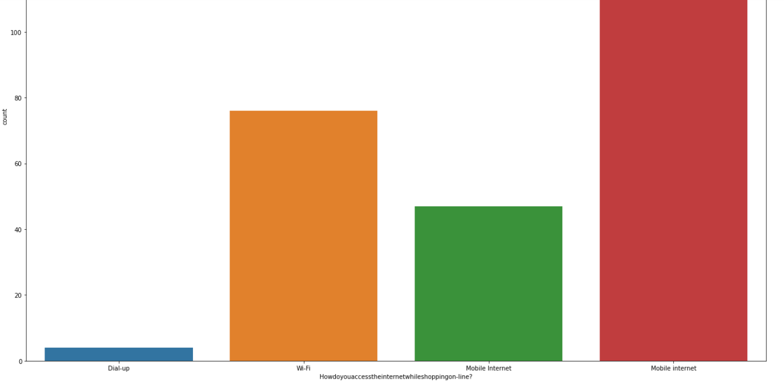
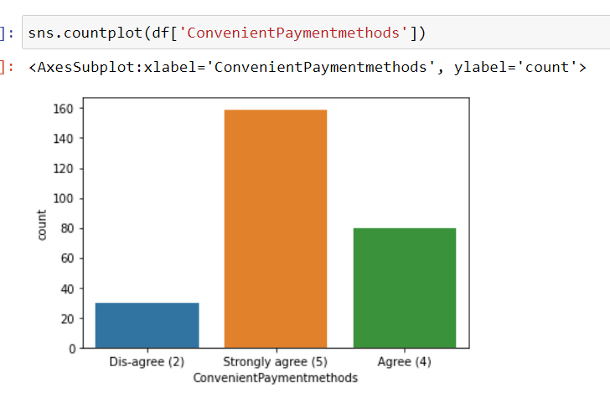
Mostly People use mobile internet for shopping.
Continent Payment Method is Strongly agree for payment method.

Slide 8
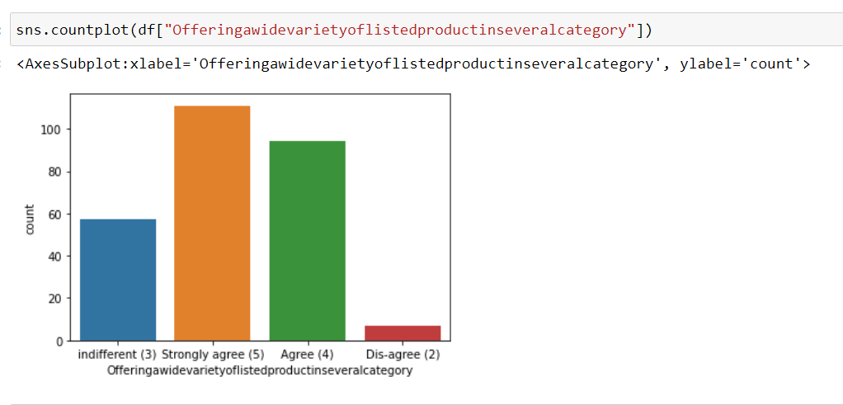
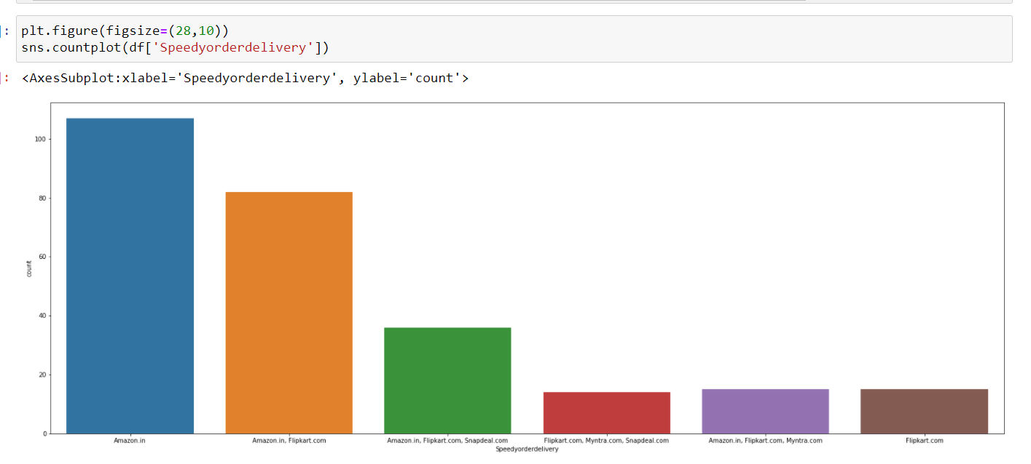
This graph shows that e-store provide wide variety of list of product in several category (Strongly agree)
Mostly Amazon gives the speed of the delivery.

Slide 9
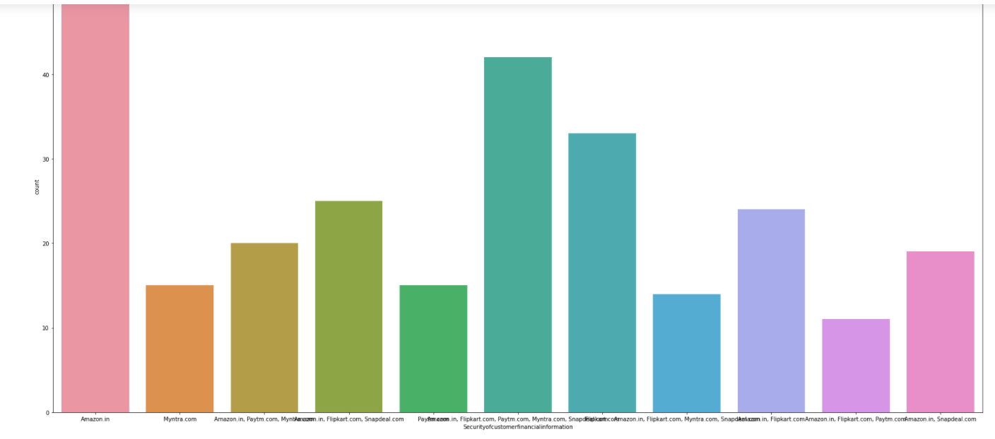
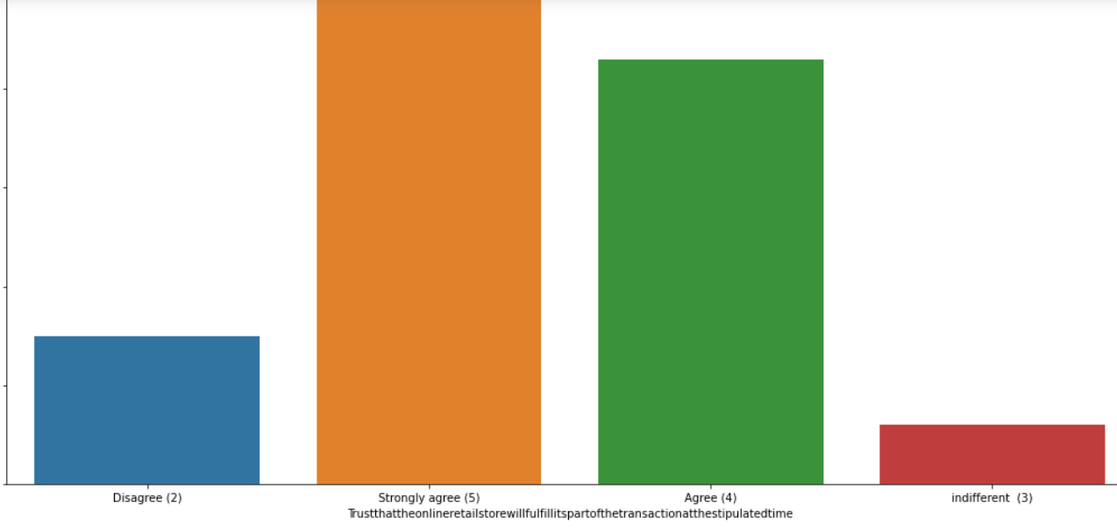

Amazon keeps the the security of customer financial information mostly shown in graph and its seems to good for the customer.
people stronly agree for the Trust that the online retail store will fulfill its part of the transaction at the stipulated time.

Slide 10
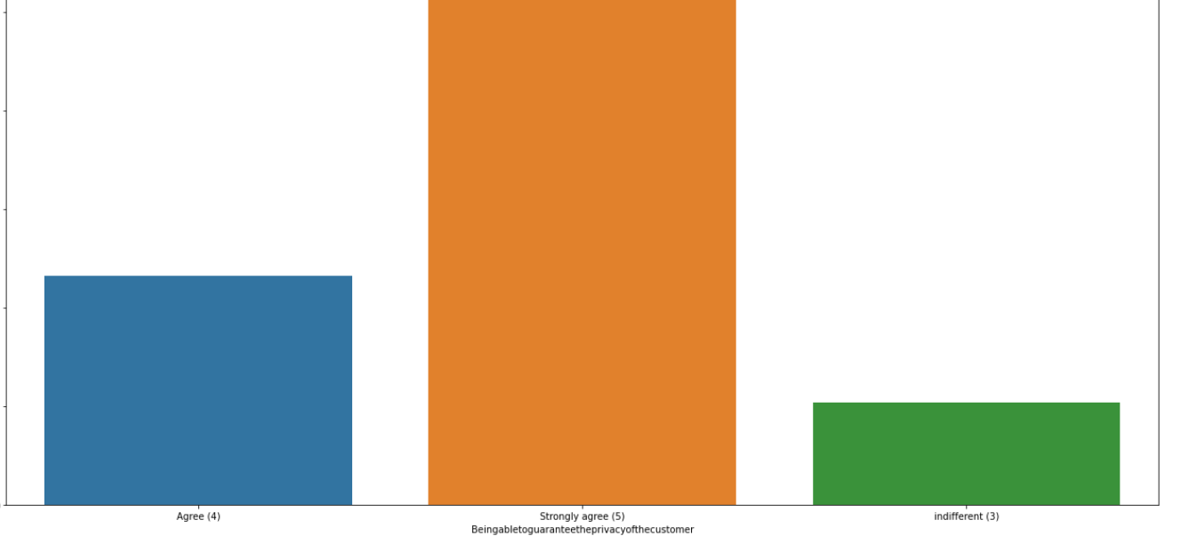
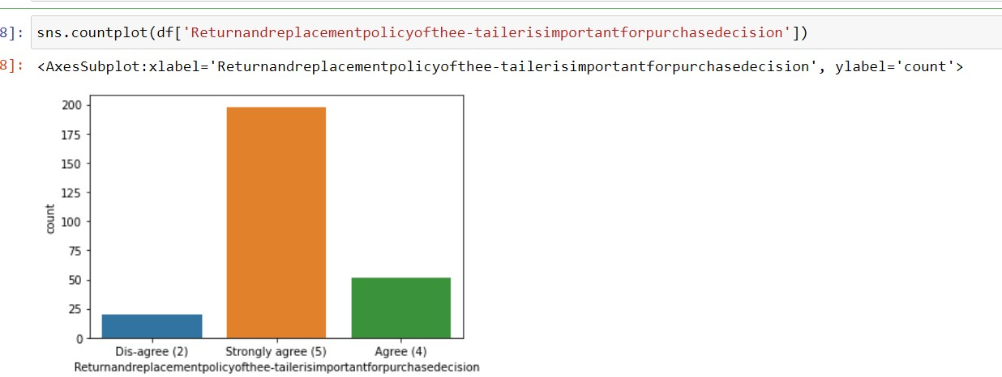

It Strongly agree for Being able to guarantee the privacy of the customer.
strongly agreed for the Return and Replacement policy is important for purchase decision is strongly

Slide 11
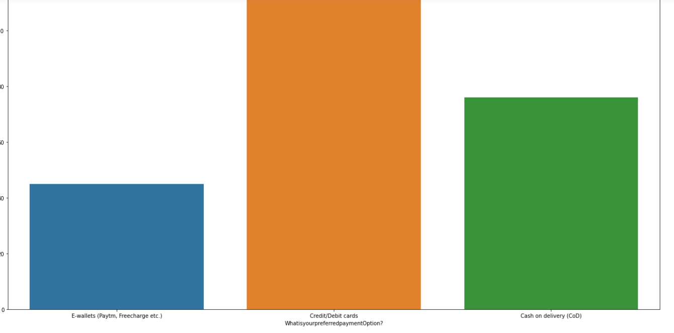
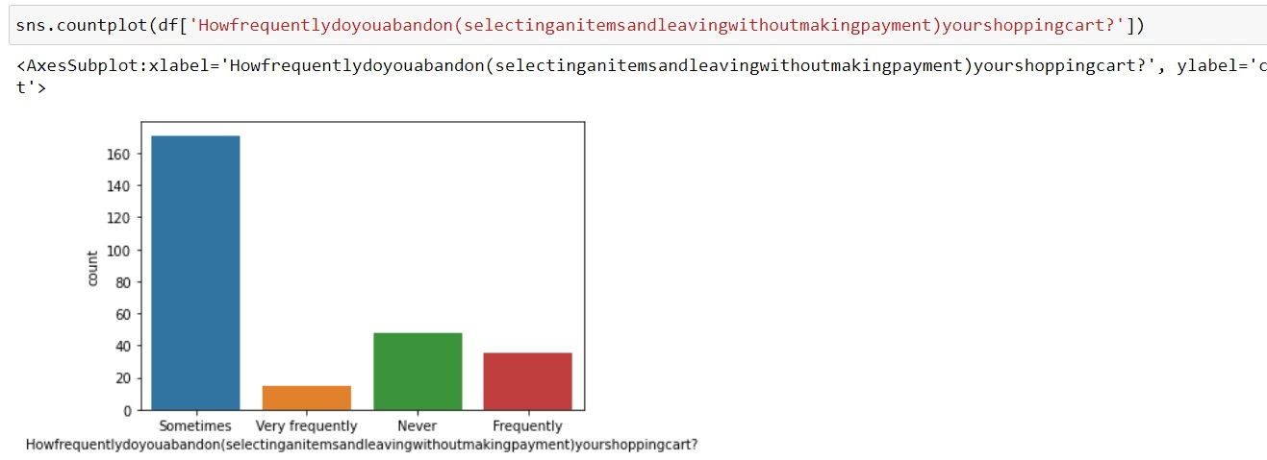
credit/debit card is perfered payment option choosen higly by the cutomers for online shopping.
Sometimes is highly countable for selecting and leaving without making payment

Slide 12
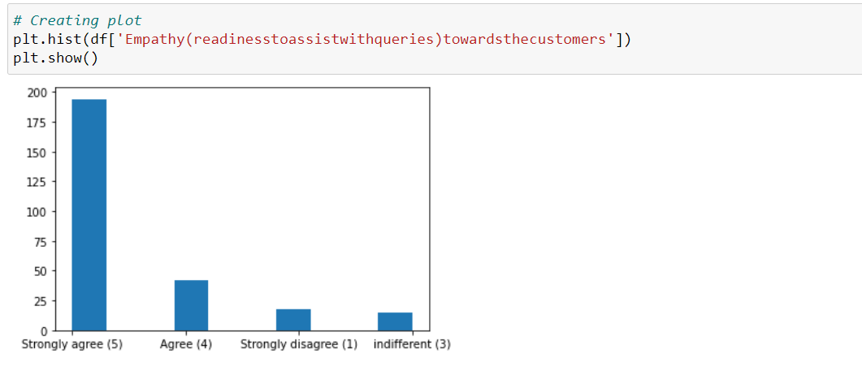

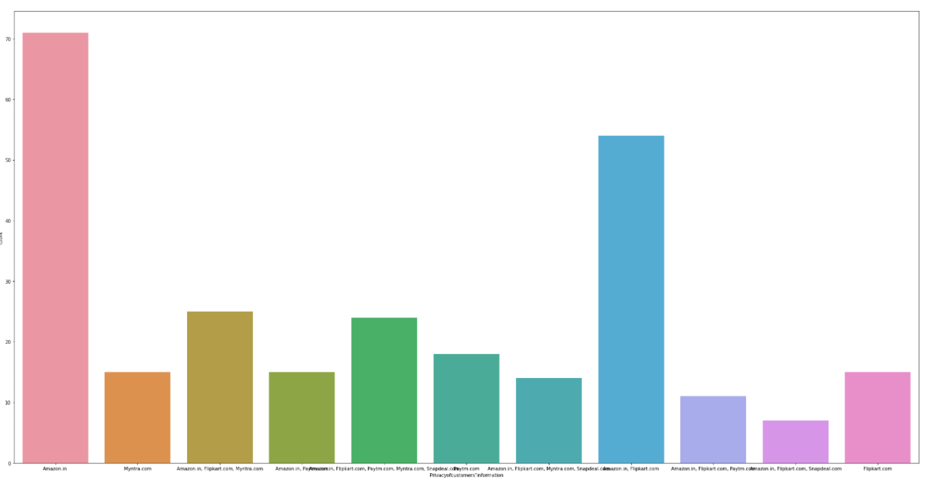
Online Strongly agreed towards Empathy readiness to assist with queries towards customer which helps more to bind the relationship.
Amazon keep the customer policy information of customers
Pre-processing

Slide 13
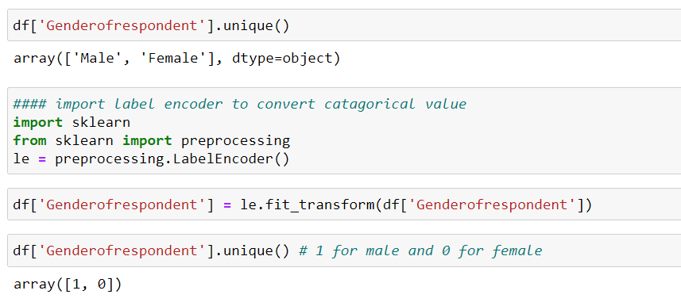
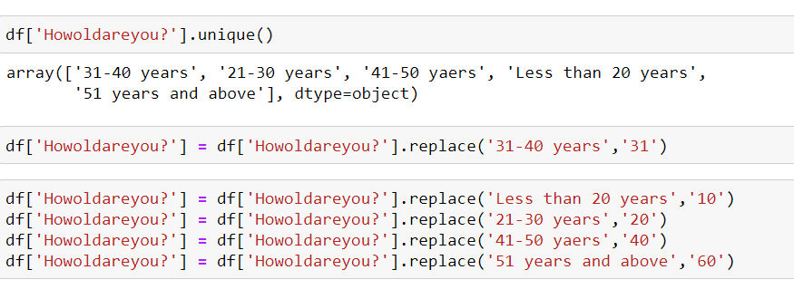
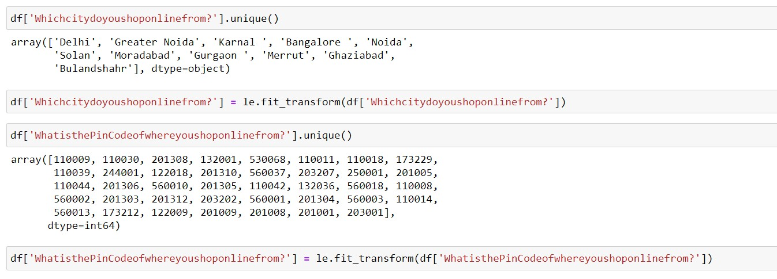
Gender of Respondent have two catagorical value which convert into 0 and 1.
## All columns are in categorical in behaviour so each column have been encoded with the help of encoder or use replace function to convert categorical value into numerical value.

Slide 14
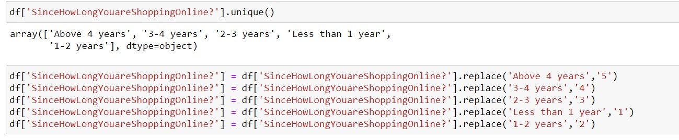
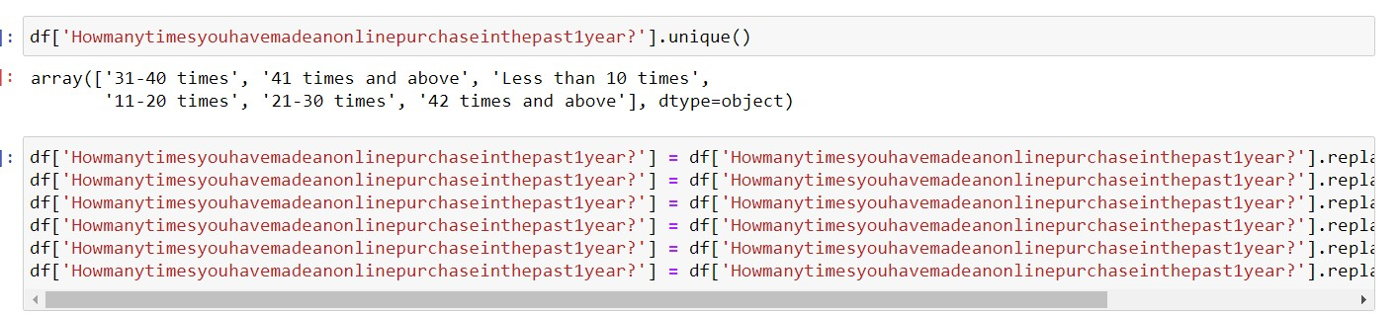
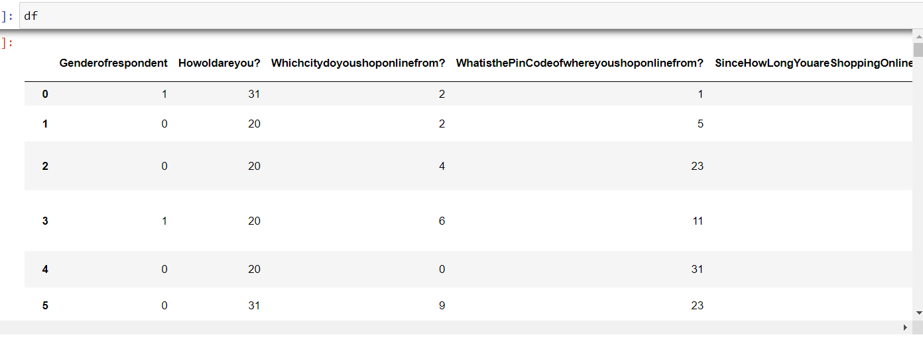
Check weather the columns are in categorical is converting into numerical or not
Its converting all columns in numerical so we will use same concept to convert the categorical fields.
df['Howdoyouaccesstheinternetwhileshoppingon-line?'] = le.fit_transform(df['Howdoyouaccesstheinternetwhileshoppingon-line?'])
df['Whichdevicedoyouusetoaccesstheonlineshopping?'] = le.fit_transform(df['Whichdevicedoyouusetoaccesstheonlineshopping?'])

Slide 15
df['Whatistheoperatingsystem(OS)ofyourdevice?']
=le.fit_transform(df['Whatistheoperatingsystem(OS)ofyourdevice?'])
df['Whatbrowserdoyourunonyourdevicetoaccessthewebsite?'] = le.fit_transform(df['Whatbrowserdoyourunonyourdevicetoaccessthewebsite?'])
df['Whichchanneldidyoufollowtoarriveatyourfavoriteonlinestoreforthefirsttime?'] = le.fit_transform(df['Whichchanneldidyoufollowtoarriveatyourfavoriteonlinestoreforthefirstti me?'])
df['Afterfirstvisit,howdoyoureachtheonlineretailstore?'] = le.fit_transform(df['Afterfirstvisit,howdoyoureachtheonlineretailstore?'])
df['Howfrequentlydoyouabandon(selectinganitemsandleavingwithoutmakingpayment)yours
hoppingcart?'] =
le.fit_transform(df['Howfrequentlydoyouabandon(selectinganitemsandleavingwithoutmakin
gpayment)yourshoppingcart?'])
df['WhatisyourpreferredpaymentOption?'] = le.fit_transform(df['WhatisyourpreferredpaymentOption?'])
df['Whydidyouabandonthe“Bag”,“ShoppingCart”?'] = le.fit_transform(df['Whydidyouabandonthe“Bag”,“ShoppingCart”?'])
df['Thecontentonthewebsitemustbeeasytoreadandunderstand'] = le.fit_transform(df['Thecontentonthewebsitemustbeeasytoreadandunderstand'])
df['Informationonsimilarproducttotheonehighlightedisimportantforproductcomparison'] = le.fit_transform(df['Informationonsimilarproducttotheonehighlightedisimportantforproduct comparison'])
df['Completeinformationonlistedsellerandproductbeingofferedisimportantforpurchasedecisi
on.'] =
le.fit_transform(df['Completeinformationonlistedsellerandproductbeingofferedisimportantf
orpurchasedecision.'])
Same code in image to show its work to convert

Slide 16
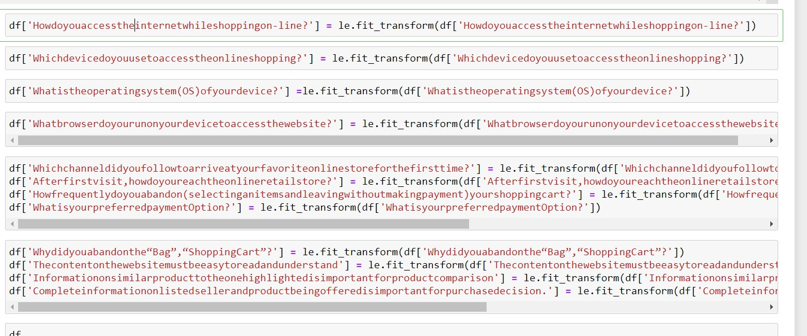
df['Whydidyouabandonthe“Bag”,“ShoppingCart”?'] = le.fit_transform(df['Whydidyouabandonthe“Bag”,“ShoppingCart”?'])
df['Thecontentonthewebsitemustbeeasytoreadandunderstand'] = le.fit_transform(df['Thecontentonthewebsitemustbeeasytoreadandunderstand'])
df['Informationonsimilarproducttotheonehighlightedisimportantforproductcomparison'] = le.fit_transform(df['Informationonsimilarproducttotheonehighlightedisimportantforproduct comparison'])
df['Completeinformationonlistedsellerandproductbeingofferedisimportantforpurchasedecisi
on.'] =
le.fit_transform(df['Completeinformationonlistedsellerandproductbeingofferedisimportantf
orpurchasedecision.'])

Slide 17
df['Allrelevantinformationonlistedproductsmustbestatedclearly'] = le.fit_transform(df['Allrelevantinformationonlistedproductsmustbesta tedclearly'])
df['Easeofnavigationinwebsite'] = le.fit_transform(df['Easeofnavigationinwebsite'])
df['Loadingandprocessingspeed'] = le.fit_transform(df['Loadingandprocessingspeed'])
df['UserfriendlyInterfaceofthewebsite'] = le.fit_transform(df['UserfriendlyInterfaceofthewebsite'])
df['ConvenientPaymentmethods'] = le.fit_transform(df['ConvenientPaymentmethods'])
df['Beingabletoguaranteetheprivacyofthecustomer'] = le.fit_transform(df['Beingabletoguaranteetheprivacyofthecustomer'])
df['Trustthattheonlineretailstorewillfulfillitspartofthetransactionatthestipulatedtime'] = le.fit_transform(df['Trustthattheonlineretailstorewillfulfillitspartofthetransactionatthestipul atedtime'])
df['Empathy(readinesstoassistwithqueries)towardsthecustomers'] = le.fit_transform(df['Empathy(readinesstoassistwithqueries)towardsthecustomers'])
df['Responsiveness,availabilityofseveralcommunicationchannels(email,onlinerep,twitter,pho
neetc.)'] =
le.fit_transform(df['Responsiveness,availabilityofseveralcommunicationchannels(email,onlin
erep,twitter,phoneetc.)'])
df['Onlineshoppinggivesmonetarybenefitanddiscounts'] = le.fit_transform(df['Onlineshoppinggivesmonetarybenefitanddiscounts'])
df['Enjoymentisderivedfromshoppingonline'] = le.fit_transform(df['Enjoymentisderivedfromshoppingonline'])
df['Shoppingonlineisconvenientandflexible'] = le.fit_transform(df['Shoppingonlineisconvenientandflexible'])
df['Returnandreplacementpolicyofthee-tailerisimportantforpurchasedecision'] = le.fit_transform(df['Returnandreplacementpolicyofthee- tailerisimportantforpurchasedecision'])
df['Gainingaccesstoloyaltyprogramsisabenefitofshoppingonline'] = le.fit_transform(df['Gainingaccesstoloyaltyprogramsisabenefitofshoppingonline'])

Slide 18
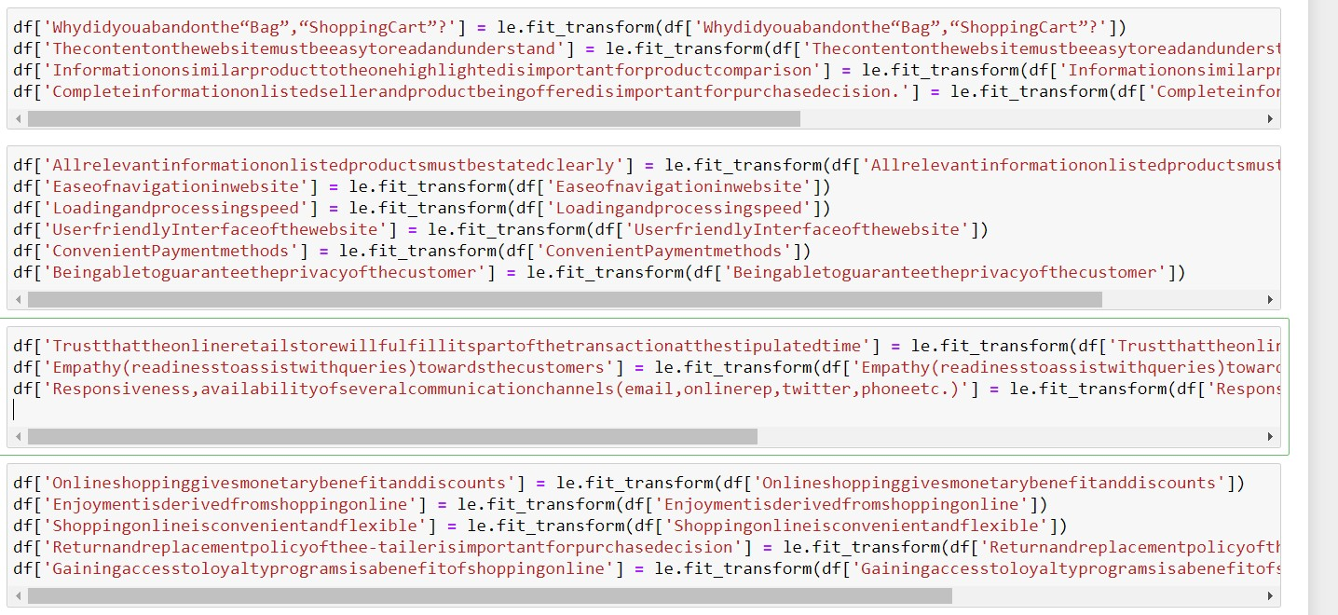
df['DisplayingqualityInformationonthewebsiteimprovessatisfactionofcustomers'] = le.fit_transform(df['DisplayingqualityInformationonthewebsiteimprovessatisfactionofcusto mers'])
df['Userderivesatisfactionwhileshoppingonagoodqualitywebsiteorapplication'] = le.fit_transform(df['Userderivesatisfactionwhileshoppingonagoodqualitywebsiteorapplicatio n'])
df['Usersatisfactioncannotexistwithouttrust'] = le.fit_transform(df['Usersatisfactioncannotexistwithouttrust'])
df['Offeringawidevarietyoflistedproductinseveralcategory'] = le.fit_transform(df['Offeringawidevarietyoflistedproductinseveralcategory'])
df['Provisionofcompleteandrelevantproductinformation'] = le.fit_transform(df['Provisionofcompleteandrelevantproductinformation'])
df['Monetarysavings'] = le.fit_transform(df['Monetarysavings'])
df['TheConvenienceofpatronizingtheonlineretailer'] = le.fit_transform(df['TheConvenienceofpatronizingtheonlineretailer'])
df['Shoppingonthewebsitegivesyouthesenseofadventure'] = le.fit_transform(df['Shoppingonthewebsitegivesyouthesenseofadventure'])
df['Shoppingonyourpreferrede-tailerenhancesyoursocialstatus'] = le.fit_transform(df['Shoppingonyourpreferrede-tailerenhancesyoursocialstatus'])
df['Youfeelgratificationshoppingonyourfavoritee-tailer'] = le.fit_transform(df['Youfeelgratificationshoppingonyourfavoritee-tailer'])

Slide 19
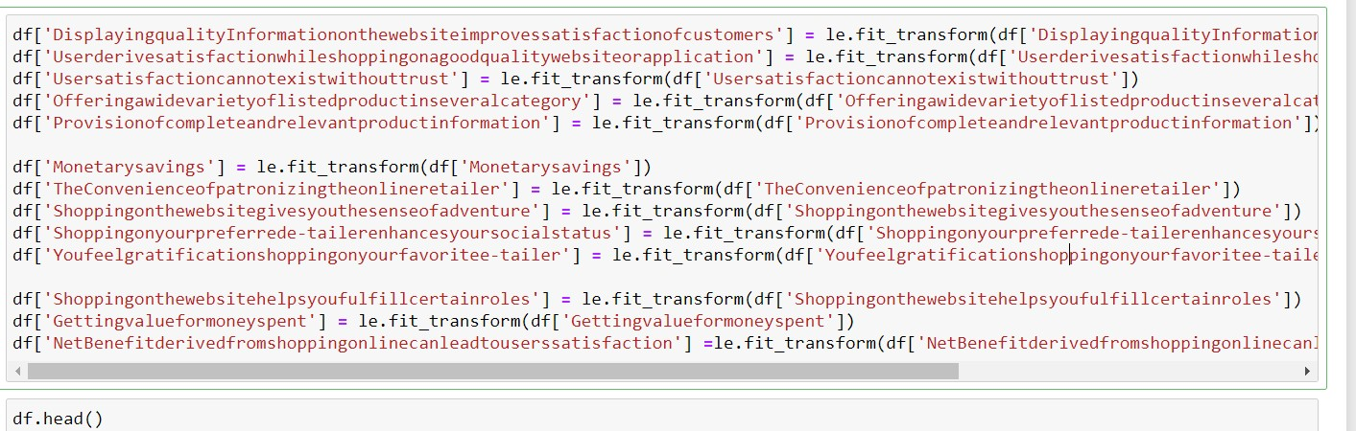
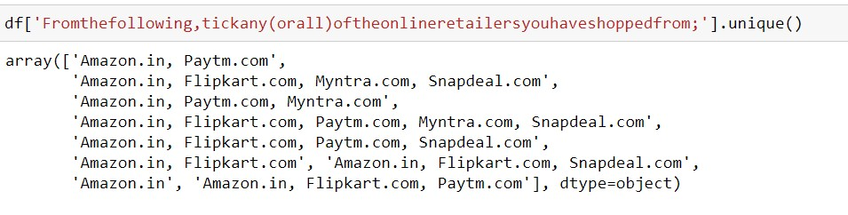
df['Shoppingonthewebsitehelpsyoufulfillcertainroles'] = le.fit_transform(df['Shoppingonthewebsitehelpsyoufulfillcertainroles'])
df['Gettingvalueformoneyspent'] = le.fit_transform(df['Gettingvalueformoneyspent'])
df['NetBenefitderivedfromshoppingonlinecanleadtouserssatisfaction']
=le.fit_transform(df['NetBenefitderivedfromshoppingonlinecanleadtouserssatisfaction'])
### head function show top 5 rows from the dataset
Now split the comma and store all values in separate columns , it will be good to predict. So lets split and separate in new one.
df['Fromthefollowing,tickany(orall)oftheonlineretailersyouhaveshoppedfrom1'] = df['Fromthefollowing,tickany(orall)oftheonlineretailersyouhaveshoppedfrom;'].str.split(',').st r[1]
df['Fromthefollowing,tickany(orall)oftheonlineretailersyouhaveshoppedfrom2'] = df['Fromthefollowing,tickany(orall)oftheonlineretailersyouhaveshoppedfrom;'].str.split(',').st r[2]

Slide 20
df['Fromthefollowing,tickany(orall)oftheonlineretailersyouhaveshoppedfrom3'] = df['Fromthefollowing,tickany(orall)oftheonlineretailersyouhaveshoppedfrom;'].str.split(',').st r[3]
df['Fromthefollowing,tickany(orall)oftheonlineretailersyouhaveshoppedfrom4'] = df['Fromthefollowing,tickany(orall)oftheonlineretailersyouhaveshoppedfrom;'].str.split(',').st r[4]
df['Fromthefollowing,tickany(orall)oftheonlineretailersyouhaveshoppedfrom5'] = df['Fromthefollowing,tickany(orall)oftheonlineretailersyouhaveshoppedfrom;'].str.split(',').st r[5]
df.drop('Fromthefollowing,tickany(orall)oftheonlineretailersyouhaveshoppedfrom;',inplace= True,axis=1)
df['Easytousewebsiteorapplication1']= df['Easytousewebsiteorapplication'].str.split(',').str[1]
df['Easytousewebsiteorapplication2']= df['Easytousewebsiteorapplication'].str.split(',').str[2]
df['Easytousewebsiteorapplication3']= df['Easytousewebsiteorapplication'].str.split(',').str[3]
df['Easytousewebsiteorapplication4']= df['Easytousewebsiteorapplication'].str.split(',').str[4]
df['Easytousewebsiteorapplication5']= df['Easytousewebsiteorapplication'].str.split(',').str[5]
df.drop('Easytousewebsiteorapplication',inplace=True,axis=1)
#### separate with comma and store in new columns separately
df['Complete,relevantdescriptioninformationofproducts1']= df['Complete,relevantdescriptioninformationofproducts'].str.split(',').str[1]
df['Complete,relevantdescriptioninformationofproducts2']= df['Complete,relevantdescriptioninformationofproducts'].str.split(',').str[2]
df['Complete,relevantdescriptioninformationofproducts3']= df['Complete,relevantdescriptioninformationofproducts'].str.split(',').str[3]
df['Complete,relevantdescriptioninformationofproducts4']= df['Complete,relevantdescriptioninformationofproducts'].str.split(',').str[4]

Slide 21
df['Complete,relevantdescriptioninformationofproducts5']= df['Complete,relevantdescriptioninformationofproducts'].str.split(',').str[5]
#### separate with comma and store in new columns separately
df['Fastloadingwebsitespeedofwebsiteandapplication1']= df['Fastloadingwebsitespeedofwebsiteandapplication'].str.split(',').str[1]
df['Fastloadingwebsitespeedofwebsiteandapplication2']= df['Fastloadingwebsitespeedofwebsiteandapplication'].str.split(',').str[2]
df['Fastloadingwebsitespeedofwebsiteandapplication3']= df['Fastloadingwebsitespeedofwebsiteandapplication'].str.split(',').str[3]
df['Fastloadingwebsitespeedofwebsiteandapplication4']= df['Fastloadingwebsitespeedofwebsiteandapplication'].str.split(',').str[4]
df['Fastloadingwebsitespeedofwebsiteandapplication5']= df['Fastloadingwebsitespeedofwebsiteandapplication'].str.split(',').str[5]
#### separet ecah value from comma and store ine variable
#### separate with comma and store in new columns separately
df['Reliabilityofthewebsiteorapplication1']= df['Reliabilityofthewebsiteorapplication'].str.split(',').str[1]
df['Reliabilityofthewebsiteorapplication2']= df['Reliabilityofthewebsiteorapplication'].str.split(',').str[2]
df['Reliabilityofthewebsiteorapplication3']= df['Reliabilityofthewebsiteorapplication'].str.split(',').str[3]
df['Reliabilityofthewebsiteorapplication4']= df['Reliabilityofthewebsiteorapplication'].str.split(',').str[4]
df['Reliabilityofthewebsiteorapplication5']= df['Reliabilityofthewebsiteorapplication'].str.split(',').str[5]
#### separet ecah value from comma and store ine variable
df['Quicknesstocompletepurchase1']= df['Quicknesstocompletepurchase'].str.split(',').str[1]
df['Quicknesstocompletepurchase2']= df['Quicknesstocompletepurchase'].str.split(',').str[2]
df['Quicknesstocompletepurchase3']= df['Quicknesstocompletepurchase'].str.split(',').str[3]
df['Quicknesstocompletepurchase4']= df['Quicknesstocompletepurchase'].str.split(',').str[4]

Slide 22
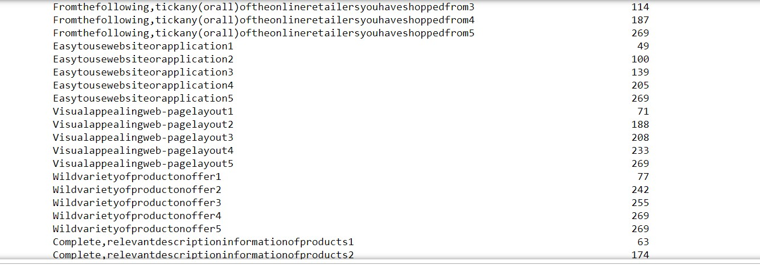
df['Quicknesstocompletepurchase5']= df['Quicknesstocompletepurchase'].str.split(',').str[5]
#### separet ecah value from comma and store ine variable
df['Availabilityofseveralpaymentoptions1']= df['Availabilityofseveralpaymentoptions'].str.split(',').str[1]
df['Availabilityofseveralpaymentoptions2']= df['Availabilityofseveralpaymentoptions'].str.split(',').str[2]
df['Availabilityofseveralpaymentoptions3']= df['Availabilityofseveralpaymentoptions'].str.split(',').str[3]
df['Availabilityofseveralpaymentoptions4']= df['Availabilityofseveralpaymentoptions'].str.split(',').str[4]
df['Availabilityofseveralpaymentoptions5']= df['Availabilityofseveralpaymentoptions'].str.split(',').str[5]
#### separet ecah value from comma and store ine variable
df['Speedyorderdelivery1']= df['Speedyorderdelivery'].str.split(',').str[1]
df['Speedyorderdelivery2']= df['Speedyorderdelivery'].str.split(',').str[2]
df['Speedyorderdelivery3']= df['Speedyorderdelivery'].str.split(',').str[3]
df['Speedyorderdelivery4']= df['Speedyorderdelivery'].str.split(',').str[4]
df['Speedyorderdelivery5']= df['Speedyorderdelivery'].str.split(',').str[5]
### now check for the null and handle the missing value. df.isnull().sum()

Slide 23
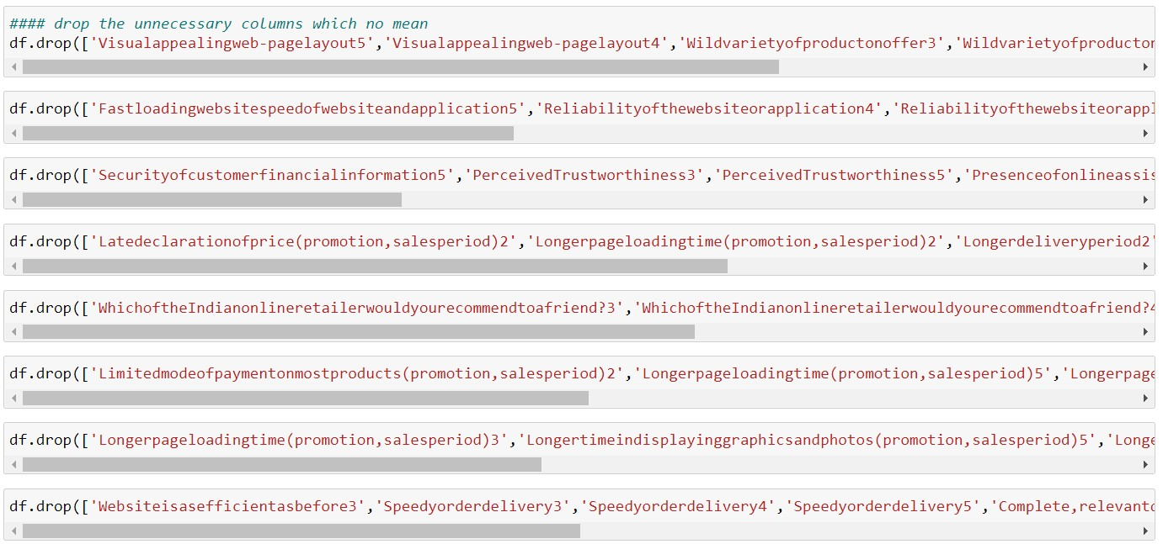
### drop the mostly count missing value because its will may overfit the model
#### drop the unnecessary columns which no mean df.drop(['Visualappealingweb-pagelayout5','Visualappealingweb-
pagelayout4','Wildvarietyofproductonoffer3','Wildvarietyofproductonoffer4','Wildvarietyofproducto
noffer5'],inplace=True,axis=1)
df.drop(['Fastloadingwebsitespeedofwebsiteandapplication5','Reliabilityofthewebsiteorapplication4'
,'Reliabilityofthewebsiteorapplication5','Quicknesstocompletepurchase3','Quicknesstocompletepurc hase4','Quicknesstocompletepurchase5','Availabilityofseveralpaymentoptions5'],inplace=True,axis=1
)
df.drop(['Securityofcustomerfinancialinformation5','PerceivedTrustworthiness3','PerceivedTrustwort
hiness5','Presenceofonlineassistancethroughmulti-
channel4','Presenceofonlineassistancethroughmulti-
channel5','Longertimetogetloggedin(promotion,salesperiod)3','Longertimetogetloggedin(promotion,
salesperiod)4','Longertimetogetloggedin(promotion,salesperiod)5'],inplace=True,axis=1)
df.drop(['Latedeclarationofprice(promotion,salesperiod)2','Longerpageloadingtime(promotion,sales period)2','Longerdeliveryperiod2','Frequentdisruptionwhenmovingfromonepagetoanother2'],inplace
=True,axis=1)
df.drop(['WhichoftheIndianonlineretailerwouldyourecommendtoafriend?3','WhichoftheIndianonline retailerwouldyourecommendtoafriend?4','WhichoftheIndianonlineretailerwouldyourecommendtoaf riend?5'],inplace=True,axis=1)

Slide 24
df.drop(['Limitedmodeofpaymentonmostproducts(promotion,salesperiod)2','Longerpageloadingtim e(promotion,salesperiod)5','Longerpageloadingtime(promotion,salesperiod)4','Longertimeindisplayi nggraphicsandphotos(promotion,salesperiod)2'],axis=1,inplace=True)
df.drop(['Limitedmodeofpaymentonmostproducts(promotion,salesperiod)2','Longerpageloadingtim e(promotion,salesperiod)5','Longerpageloadingtime(promotion,salesperiod)4','Longertimeindisplayi nggraphicsandphotos(promotion,salesperiod)2'],axis=1,inplace=True)
df.drop(['Longerpageloadingtime(promotion,salesperiod)3','Longertimeindisplayinggraphicsandphot os(promotion,salesperiod)5','Longertimeindisplayinggraphicsandphotos(promotion,salesperiod)3','L ongertimeindisplayinggraphicsandphotos(promotion,salesperiod)4'],inplace=True,axis=1)
df.drop(['Websiteisasefficientasbefore3','Speedyorderdelivery3','Speedyorderdelivery4','Speedyorde rdelivery5','Complete,relevantdescriptioninformationofproducts4','Fromthefollowing,tickany(orall)of theonlineretailersyouhaveshoppedfrom5'],axis=1,inplace=True)
df.drop(['Easytousewebsiteorapplication5','Complete,relevantdescriptioninformationofproducts5','P rivacyofcustomers’information5','PerceivedTrustworthiness4'],axis=1,inplace=True)
df.drop(['Securityofcustomerfinancialinformation1','WhichoftheIndianonlineretailerwouldyourecom mendtoafriend?1','Changeinwebsite/Applicationdesign1','Reliabilityofthewebsiteorapplication3'],inp lace=True,axis=1)
### in rest of missing value I have filled with None Value. Because most of the columns do not have the features to like fast delivery /security of customer information/easy to use website/long page reloading time most people not face this issue its means none so I have replaced all missing value with None vale and applied Label encoder to convert all categorical value or feature column into numeric now data is ready for modal.

Slide 25
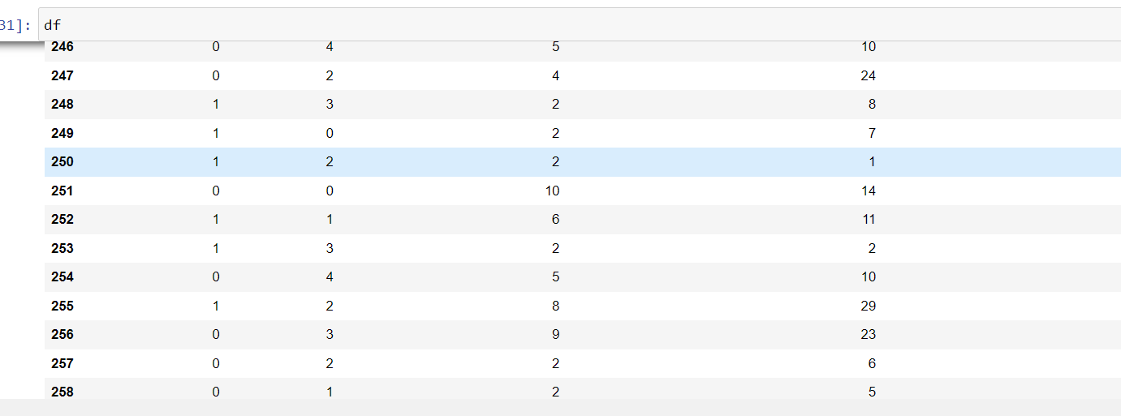
Conclusion:
Customer aspect various things from the online store like privacy, vide variety of product, payment Efficiency, fast delivery orders, mostly used payment method many more. If customer gets the satisfaction, it automatically builds the relationship. From visualization customer agree with payment option , fast delivery/speedy delivery ,privacy of customer information and privacy of account/financial statement. I have visualized the scenario to understand what customer need during online shopping so any one feasible to keep relationship .After Visualization clean the data remove missing value and used scaling techniques for building the best model.

